Slide 1
Flow control and error control techniques in the data link layer protocols.
Presented by
Nazmus Sakib Patwary ID: 2015-2-60-092
Sohely Towhid ID: 2015-2-60-101
Nabil Al Raian ID: 2015-2-60-081

Slide 2
Overview
Introduction
Stop and Wait
Pros and cons
Simulation results
Conclusion

Slide 3
Introduction
In this project we are going to implement data link layer protocol using stop and wait, timeout, positive acknowledgment and retransmission. As our requirement, we are using CRC-16 to as the generator polynomial.

Slide 4
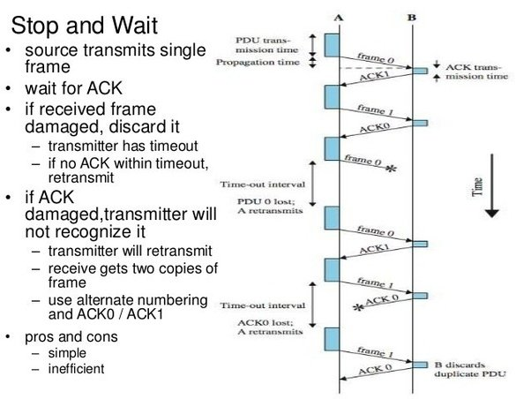
STOP AND WAIT

Slide 5
Pros
Simplest form
Source transmits frame
Destination receives frame and replies with acknowledgement

Slide 6
Cons
It is usually lengthy because of sender’s waiting for ACK after every frame.
If data gets divided into more frames then it will be lengthy even more.
With longer transition, the possibility of getting errors rise higher.

Slide 7
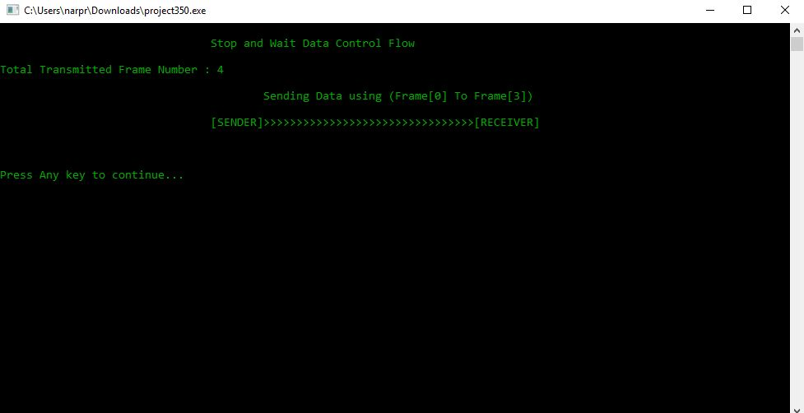
Simulation result
1.For this example of test case we take 4 frame as input and each frame we consider the data segment is 40 bits long. The predetermined divisor is 17 bit long and total frame size is 57 bit.

Slide 8
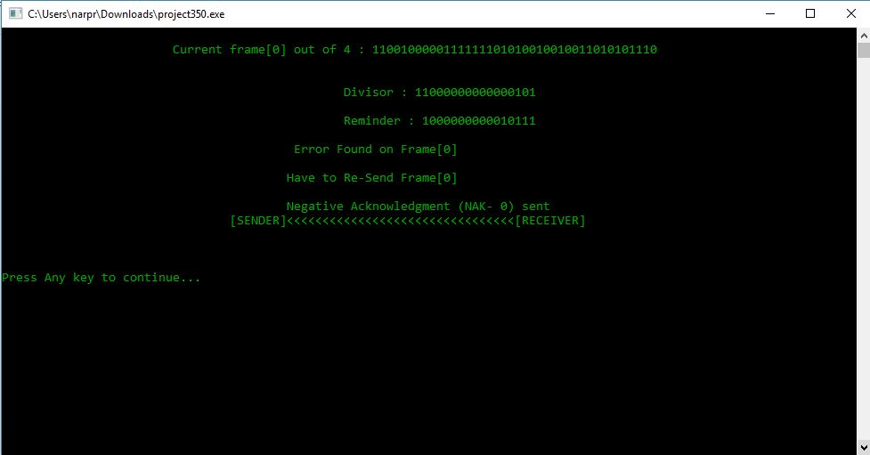
2. This time Receiver got an error in the data and it sent back NAK-0 that means Transmitter need to send Frame[0] again because there was a problem in the Frame[0]

Slide 9
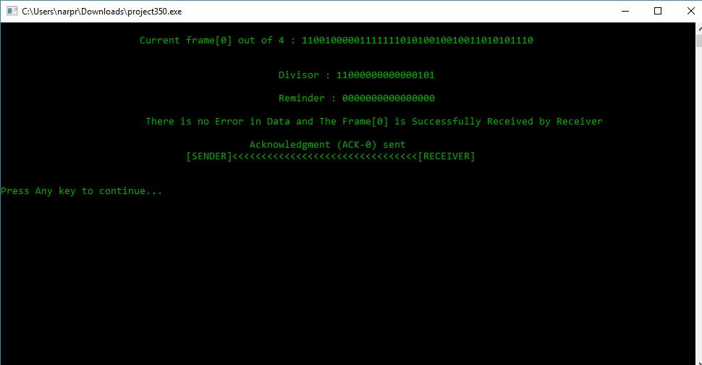
3. This time Transmitter sent Frame[0], Frame[1], Frame[0] and so on one after another consecutively and Receiver sent back to Transmitter to ACK-1, ACK-0, ACK-1 and so on if Receiver got no error.

Slide 10
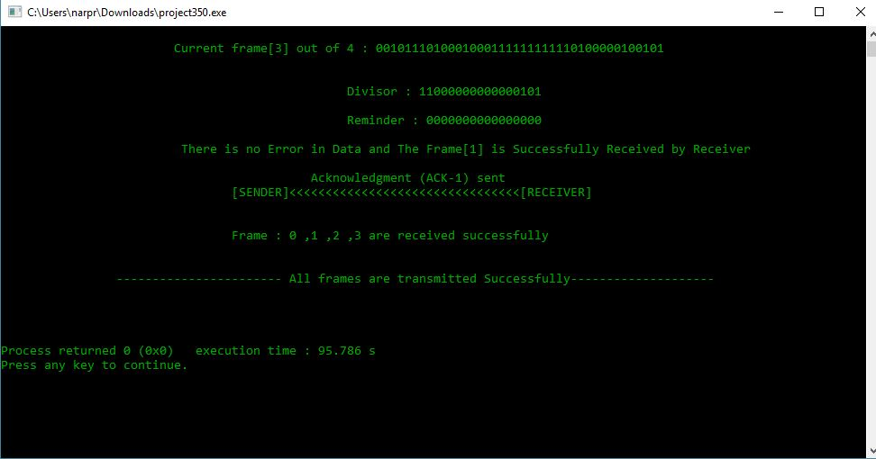
4. At the end when all of the frame successfully sent to the receiver end and Receiver sent ACK to the Transmitter.

Slide 11
Conclusion
In this project we try to implement Stop and Wait data link protocol efficiently. For our memory limitation we used sample data segment very short bit. By implementing this project we could not sent data practically. For showing error in the data segment we forcefully substitute few bits of its original bit.

Slide 12


